Slide 1
Welcome to
New to the
Early Years Foundation Stage (EYFS) for Reception
Cath Davenport
EYFS Quality & Improvement Adviser

Slide 2
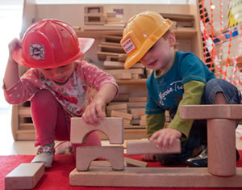
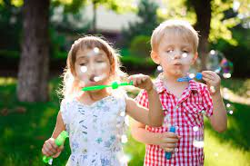
Develop awareness of, and confidence in, understanding and implementing the
Early Years Foundation Stage (EYFS)
Introduce practitioners to the Early Years Foundation Stage documents
Aims and Objectives
Introduce the EYFS Profile and GLD (Good Level of Development)
To look at the practitioner role and the benefits of working with parents and carers

Slide 3
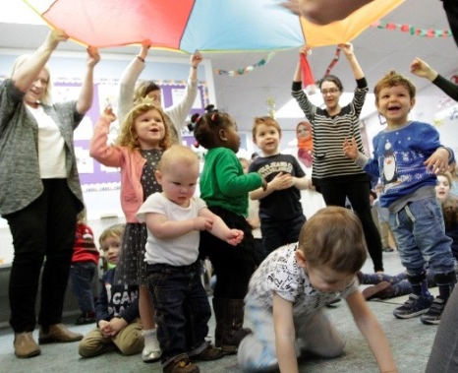
Quality and consistency in all Early Years settings, so that every child makes good progress and no child gets left behind
Equality of opportunity and anti-discriminatory practice, ensuring that every child is included and supported
What does the EYFS seek to provide?
A secure foundation through planning for the learning and development of each individual child, and assessing and reviewing what they have learned regularly
Partnership working between practitioners and with parents and carers

Slide 4
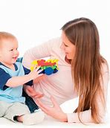
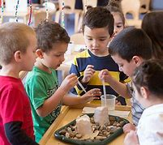
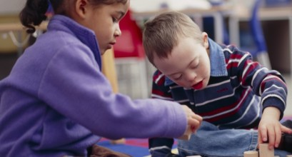
Every child is a unique child, who is constantly learning and can be resilient, capable, confident and self assured.
Children learn to be strong and independent through positive relationships
Overarching Principles
Four guiding principles should shape practice in Early Years Settings.
Children learn and develop well in enabling environments with teaching and support from adults, who respond to their individual interests and needs and help them to build their learning over time.
Children benefit from a strong partnership between practitioners and parents/carers.
Importance of learning and development. Children develop and learn at different rates. The framework covers the education and care of all children in early years provision, including children with special educational needs and disabilities.

Slide 5
Early Years Foundation Stage Documents
Statutory Framework for the EYFS 2021
EYFS Profile Handbook
Ofsted Inspection handbook 2021
Development Matters in the EYFS

Slide 6
Statutory framework for the Early Years
Foundation Stage
Section One
Learning and development requirements
Section Two
Assessment
Section Three
Safeguarding and Welfare requirements

Slide 7
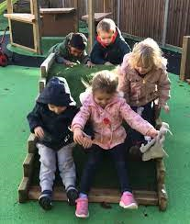
Section 1 - Learning and Development
3 Prime Areas
Personal, Social & Emotional Development
Communication & Language Development
Physical Development
4 Specific Areas
Literacy
Mathematics
Understanding the World
Expressive Art & Design
Prime:
Time sensitive
Universal
Not dependent on the specific areas
Specific:
Less time sensitive
Culturally specific
Dependent on the prime areas

Slide 8
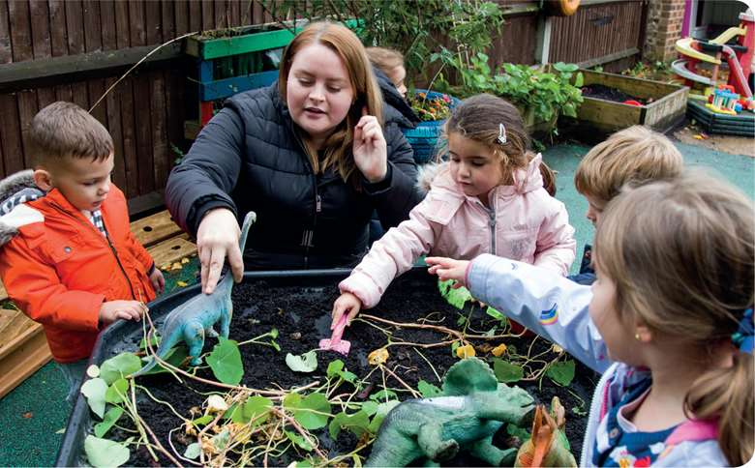
Section 2 - Assessment
Assessment plays an important part in helping parents, carers and practitioners to recognise children’s progress, understand their needs, and to plan activities and support.
IMPORTANT REMINDER:
Assessment should not entail prolonged breaks from
interaction with children, nor require excessive paperwork
Formative
Summative
Formative, or ongoing, assessment is integral to the learning and development process.
Summative Assessments to be completed by practitioners at relevant times:

Slide 9
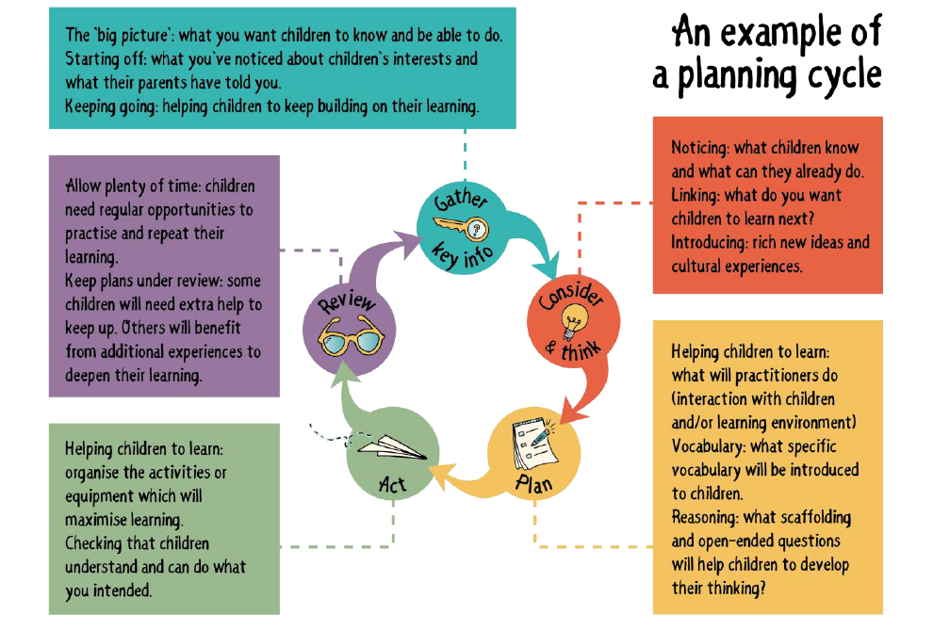
(Section 2) Ongoing Formative Assessment
Credit: Julian Grenier
“Working with the revised EYFS: Principles into Practice

Slide 10
Progress check at age two Reception Baseline Assessment EYFS Profile
(Section 2) Summative assessments

Slide 11
(Section 2) Summative Assessments
Early Years Foundation Stage Profile
In the final term of the year in which the child reaches age five the EYFS Profile must be completed for each child.
The Profile provides parents and carers, practitioners and teachers with a well-rounded picture of a child’s knowledge, understanding and abilities, their attainment against expected levels, and their readiness for year 1.
Each child’s level of development must be assessed against the early learning goals.
Practitioners must indicate whether children are meeting expected levels of development, or if they are not yet reaching expected levels (‘emerging’). This is the EYFS Profile.
Early Learning Goals
Within each of the 7 areas of learning are the ‘Early Learning Goals’.
These summarise the knowledge, skills and understanding that all young children should have gained by the end of the reception year.

Slide 12
Section 3 - Safeguarding and Welfare requirements
Safeguarding is the action that is taken to promote the welfare of children and protect them from harm.
Children learn best when they are healthy, safe and secure, when their individual needs are met, and when they have positive relationships with the adults caring for them.

Slide 13
EYFSP Handbook
Published annually in the Autumn term
Contains the Early Learning Goals
As well as advice and guidance on making assessments and completing the Early Years Foundation Stage profile, the handbook includes useful information supporting successful pedagogy

Slide 14
Good Level of Development (GLD)
Each of the 7 Areas of Learning has 2 or 3 Early Learning Goals (ELGs) that summarise the knowledge, skills and understanding all young children should gain by the end of YR
There are 17 ELGs in total

Slide 15
Good Level of Development (GLD)
Good Level of Development (GLD) comprises the first 12 ELGs (all C&L; all PSED; all PD; Lit & Math)
Children need the Expected level in all 12 ELGs to attain GLD.
% of YR children attaining GLD, nationally in 2019, was 71.8%

Slide 16
Ofsted Education Inspection Framework Evaluating the quality of EY education in schools
Updated June 2021
Effective September 2021
School governor-led settings: short section on 2&3 Yr. Olds (326)
Characteristics of Effective T&L (325)
Teaching definition (325)
‘Developing vocabulary’ (327)
‘EYFS Good’ section ‘Impact’ : By the end of YR, children have the personal, physical & social skills to succeed…..most children achieve Maths & Literacy ELGs (327)

Slide 17
Development Matters
This is a non-statutory guidance to support Practitioners in implementing the statutory requirements of the EYFS.

Slide 18
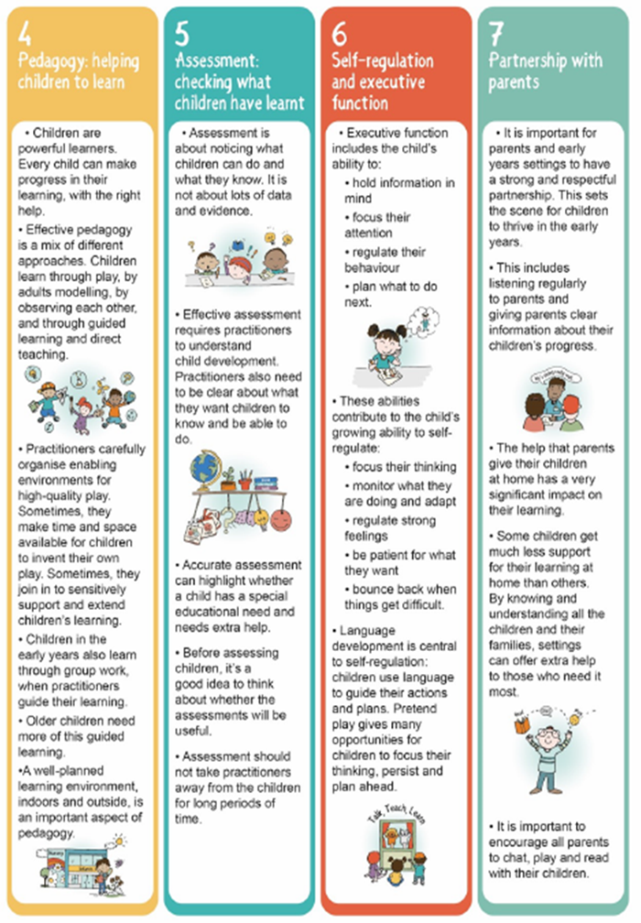
Seven Features of Effective Practice
Development Matters
Credit: Julian Grenier
“Working with the revised EYFS: Principles into Practice

Slide 19
Development matters
Development Matters
Characteristics of Effective Teaching and Learning
“In planning and guiding what children learn, practitioners must reflect on the different rates at which children are developing and adjust their practice appropriately”
Three characteristics of effective teaching and learning are:
Playing and exploring
Active learning
Creating and thinking critically

Slide 20
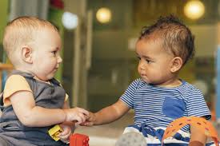
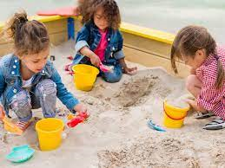
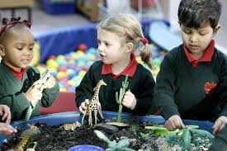
Three Age Bands for Assessment
Development Matters
Birth to Three: Babies, toddlers & young children
Three & Four Year Olds
Children in Reception

Slide 21
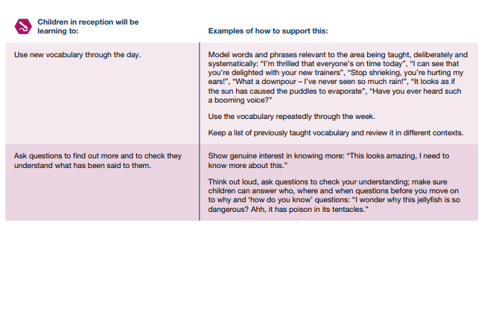
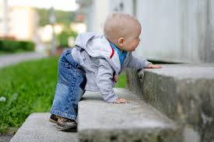
Development Matters
Reception example
- Communication and Language

Slide 22
A Reception Year
Autumn term
Home visits
Reception Baseline Assessment (RBA)
‘Starting-points assessment ,’to include Prime Areas
Start phonics promptly and equitably– especially if you have a staggered start
Model routines and behaviour, model play and how to use equipment & resources etc.,
Consider how experiences such as whole school assembly and whole school playtime might be introduced over the next few months
Spring Term
Look at ELGs & become familiar with them
Look out for LA workshops offering training and advice in assessment and completing the Profile
Summer Term
Look out for LA offer of non-statutory ‘Quality Assurance’ of Profile judgements , by request
EYFS Profile judgements submitted to LA (end June)
.
Remember to consider arranging transition opportunities throughout the year – not just in the summer
.

Slide 23
Working with Parents and Carers
Working in partnership with parents and/or carers is a key feature of the Early Years Foundation Stage (EYFS).
Consulting them about children’s early experiences helps practitioners plan for effective learning at the setting, and helps them support parents in continuing their children's learning development at home.
Achieving this takes time, reflective practice, skill and a solid understanding of the barriers that can impede forming effective working relationships with parents
Working parents
Shy/anxious
Potential barriers?
Younger siblings
Embarrassed
Feeling judged
Practitioners misconceptions of Parent’s abilities
Language and communication

Slide 24
What next? CCatCath
Look out for the follow-up session for teachers new to reception, which will be toward the end of the autumn term, available through GCC+
If you would
like to be part of a New to Reception virtual network , please email me : catherine.davenport@gloucestershire.gov.uk, and copy in:
denise.webb@gloucestershire.gov.uk

Slide 25
Thank you for listening CCatCath
New to the
Early Years Foundation Stage
(EYFS)
Cath Davenport catherine.davenport@gloucestershire.gov.uk

