Slide 1
Welcome to
New to the
Early Years Foundation Stage (EYFS)
for Preschool
Trainer: Charlotte Smith
Early Years Lead Advisor

Slide 2
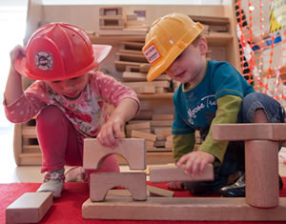
To introduce and develop practitioner’s awareness and confidence in understanding and implementing the
Early Years Foundation Stage (EYFS)
To introduce practitioners to the Early Years Foundation Stage documents
Aims and Objectives
To develop an understanding of the safeguarding and welfare requirements,
and how these are interwoven into the overarching principles of the EYFS.
To look at the practitioner role and the benefits of working with parents and carers

Slide 3
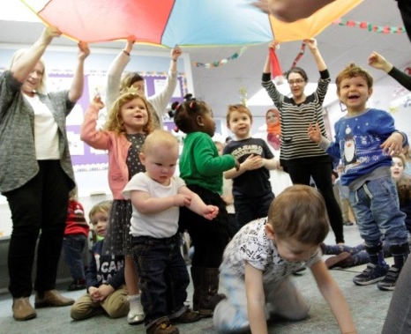
Quality and consistency in all Early Years settings, so that every child makes good progress and no child gets left behind
Equality of opportunity and anti-discriminatory practice, ensuring that every child is included and supported
What does the EYFS seek to provide?
A secure foundation through planning for the learning and development of each individual child, and assessing and reviewing what they have learned regularly
Partnership working between practitioners and with parents and carers

Slide 4
Looking at the
Early Years Foundation Stage Documents
Statutory Framework for the EYFS 2021
The EYFS Progress check at age two
Ofsted Early Years Inspection handbook 2021
Development Matters in the EYFS

Slide 5
Statutory framework for the Early Years
Foundation Stage
This document sets out all the
legal requirements of the EYFS.
It includes detailed information
on providers obligations under
the framework
The document is split into three main sections, let’s look at them together…

Slide 6
Section One
The learning and development requirements
What providers must do, working in partnership with parents/carers to promote the learning and development of all children in their care.
The areas of learning and development which must shape the activities and experiences (educational programmes) for children in all early years settings
The early learning goals that providers must help children work towards (the knowledge, skills and understanding children should have at the end of the academic year in which they turn five)

Slide 7
Section Two
Assessment
The process of recognising children’s progress, understanding their needs, and to plan activities and support.
We will also look at the requirements for reporting these to parents/guardians, and information that should be provided to the Local Authority.
Progress check at age two
Assessment at the end of the EYFS - the Early Years Foundation Stage Profile

Slide 8
Section Three
The Safeguarding and Welfare requirements
The necessary steps that providers must take to keep children safe and promote their welfare

Slide 9
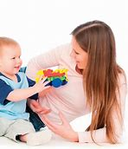
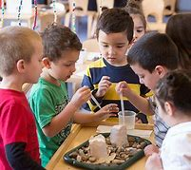
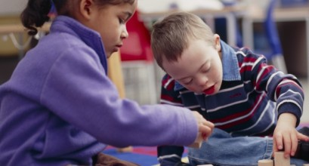
Every child is a unique child, who is constantly learning and can be resilient, capable, confident and self assured.
Children learn to be strong and independent through positive relationships
Overarching Principles
Four guiding principles should shape practice in Early Years Settings.
Children learn and develop well in enabling environments with teaching and support from adults, who respond to their individual interests and needs and help them to build their learning over time.
Children benefit from a strong partnership between practitioners and parents/carers.
Importance of learning and development. Children develop and learn at different rates. The framework covers the education and care of all children in early years provision, including children with special educational needs and disabilities.

Slide 10
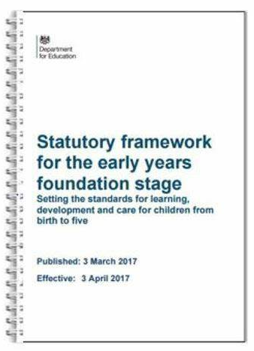
Statutory Framework - Section One
The learning and development requirements
What providers must do, working in partnership with parents/carers to promote the learning and development of all children in their care.
The areas of learning and development which must shape the activities and experiences (educational programmes) for children in all early years settings
The early learning goals that providers must help children work towards (the knowledge, skills and understanding children should have at the end of the academic year in which they turn five)

Slide 11
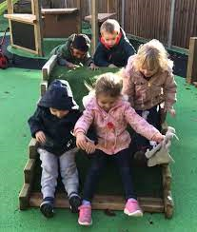
7 areas of learning and development
Prime Areas
Personal, Social & Emotional Development
Communication & Language Development
Physical Development
Specific Areas
Literacy
Mathematics
Understanding the World
Expressive Art & Design
Prime:
Time sensitive
Universal
Not dependent on the specific areas
Specific:
Less time sensitive
Culturally specific
Dependent on the prime areas

Slide 12
Development Matters
This is a non-statutory guidance to support Practitioners in implementing the statutory requirements of the EYFS.

Slide 13
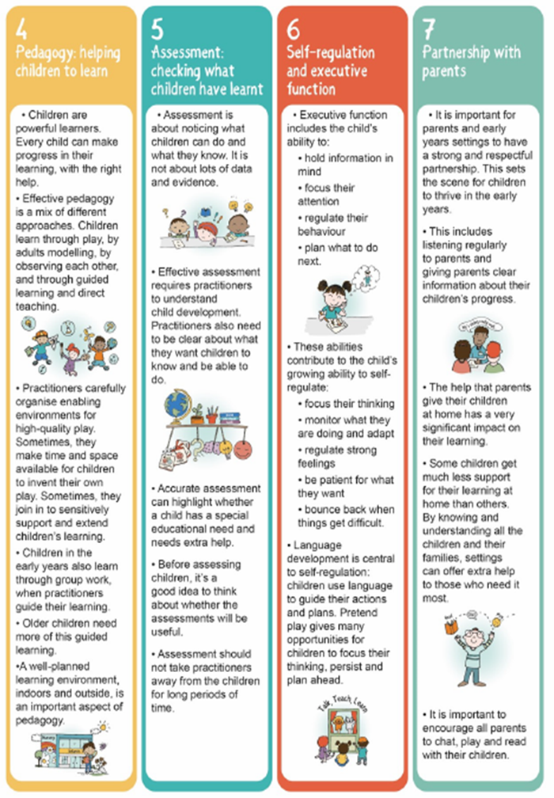
Seven Features of Effective Practice
Development Matters
Credit: Julian Grenier
“Working with the revised EYFS: Principles into Practice

Slide 14
Development matters
Development Matters
Characteristics of Effective Teaching and Learning
“In planning and guiding what children learn, practitioners must reflect on the different rates at which children are developing and adjust their practice appropriately”
Three characteristics of effective teaching and learning are:
Playing and exploring
Active learning
Creating and thinking critically

Slide 15
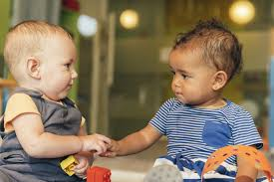
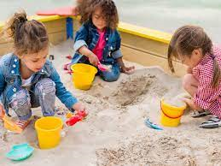
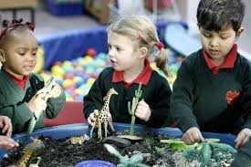
Three Age Bands for Assessment
Development Matters
Birth to Three: Babies, toddlers & young children
Three & Four Year Olds
Children in Reception

Slide 16
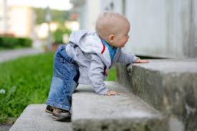
Development Matters
Birth to three example
- Communication and Language

Slide 17
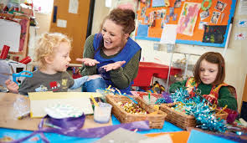
Development Matters
3 and 4 year olds example
- Communication and Language

Slide 18
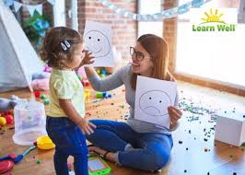
Development Matters
Observation checkpoints in DM
help practitioners notice a child at risk of falling behind in their development

Slide 19
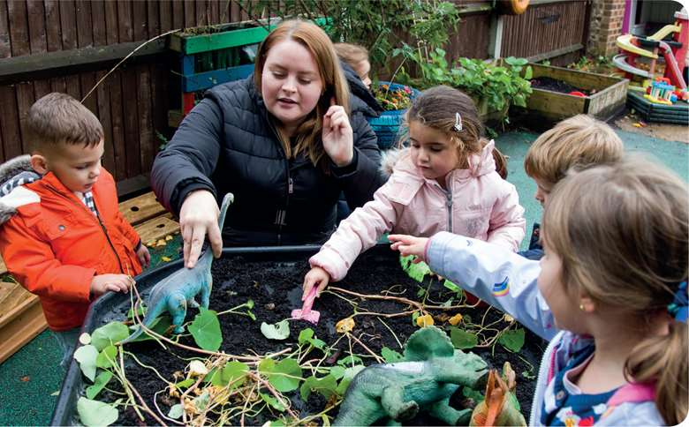
Section Two:
What is Assessment?
Assessment plays an important part in helping parents, carers and practitioners to recognise children’s progress, understand their needs, and to plan activities and support.
IMPORTANT REMINDER:
Assessment should not entail prolonged breaks from
interaction with children, nor require excessive paperwork
Formative
Summative
Formative assessment (ongoing assessment) is an integral part of the learning and development process.
It involves practitioners knowing children’s level of achievement and interests, and then shaping teaching and learning experiences for each child reflecting that knowledge.
Summative Assessments must be completed by practitioners at the relevant times.
Today we will look at the ‘Progress check at age two’, and the’ EYFS Profile’ at the end of a child’s reception year.

Slide 20
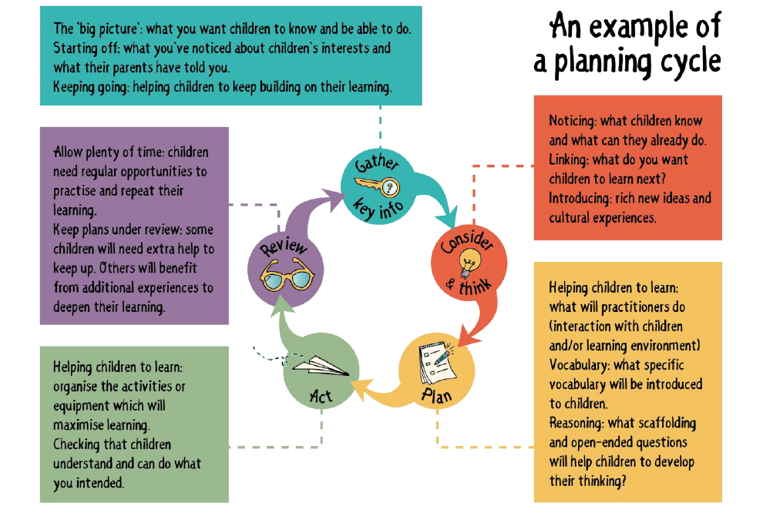
Ongoing Formative Assessment
Credit: Julian Grenier
“Working with the revised EYFS: Principles into Practice

Slide 21
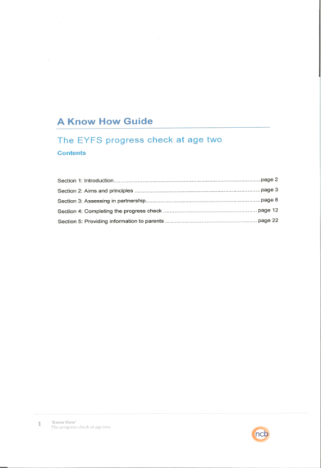
Summative Assessments
A Know How Guide –
The EYFS Progress Check at age two
This guide supports Practitioners to complete the EYFS Progress check at age two.
Completion of this is a statutory requirement.

Slide 22
Summative Assessments
Early Years Foundation Stage Profile
In the final term of the year in which the child reaches age five the EYFS Profile must be completed for each child.
The Profile provides parents and carers, practitioners and teachers with a well-rounded picture of a child’s knowledge, understanding and abilities, their attainment against expected levels, and their readiness for year 1.
Each child’s level of development must be assessed against the early learning goals.
Practitioners must indicate whether children are meeting expected levels of development, or if they are not yet reaching expected levels (‘emerging’). This is the EYFS Profile.
Early Learning Goals
Within each of the 7 areas of learning are the ‘Early Learning Goals’.
These summarise the knowledge, skills and understanding that all young children should have gained by the end of the reception year.

Slide 23
Section Three
The Safeguarding and Welfare requirements
What is safeguarding?
Safeguarding is the action that is taken to promote the welfare of children and protect them from harm.
Why is this section in the Early Years Foundation Stage Framework?
Children learn best when they are healthy, safe and secure, when their individual needs are met, and when they have positive relationships with the adults caring for them.

Slide 24
Section Three
The Safeguarding and Welfare requirements
The necessary steps that providers must take to keep children safe and promote their welfare
Child Protection
Key Person
Safety and suitability of premises, environment and equipment
Smoking and vaping
Premises
Risk Assessment
Outings
Suitable People
Staff:Child ratios
Early Years Providers
Before/After School Care and holiday provision
Childminders
Disqualification
Information and Records
Information about the child
Information for parents and carers
Complaints
Information about the provider
Changes requiring notification
Health
Medicines
Food and drink
Accident or injury
Staff taking medication/other substances
Special Educational Needs
Staff Qualification, training, support and skills
Managing children’s behaviour

Slide 25
Section Three
The Safeguarding and Welfare requirements
Child Protection
(Page 21)
“Providers must be alert to any issues of concern in the child’s life at home or elsewhere”
“Providers must have and implement a policy, and procedures, to safeguard children.”
Staff Qualification, training, support and skills
(Page 26)
“The daily experience of children in early years settings and the overall quality of provision depends on all practitioners having appropriate qualifications, training, skills, knowledge, and a clear understanding of their roles and responsibilities. Providers must ensure that all staff receive induction training to help them understand their roles and responsibilities.”
Key Person
(Page 27)
“Every child must be assigned a key person”
A lot of the role and skills required to be a Key Person are the same as any Practitioner supporting the children that they work with.

Slide 26
Key Person Role
The EYFS statutory framework states:
Each child must be assigned a key person, and providers must inform parents and carers of the name of the key person, and explain their role, when a child starts attending a setting.
The key person must help ensure that every child’s learning and care is tailored to meet their individual needs.
The key person must seek to engage and support parents and carers in guiding their child’s development at home. They should also help families engage with more specialist support if appropriate.
Role
Settling in children alongside parents and carers
Ensuring that care and learning opportunities always meet children’s needs
Forming attachments
Liaising with parents and carers
Skills
Calm, and confident
Sensitive and tactful
Open and honest
Good communication

Slide 27
Working with Parents and Carers
Working in partnership with parents and/or carers is a key feature of the Early Years Foundation Stage (EYFS).
Consulting them about children’s early experiences helps practitioners plan for effective learning at the setting, and helps them support parents in continuing their children's learning development at home.
Achieving this takes time, reflective practice, skill and a solid understanding of the barriers that can impede forming effective working relationships with parents
Working parents
Shy/anxious
Potential barriers?
Younger siblings
Embarrassed
Feeling judged
Practitioners misconceptions of Parent’s abilities
Language and communication

Slide 28
Ofsted –
Early Years Inspection Handbook
Updated June 2021
Effective September 2021
Handbook content
How Ofsted will inspect
The evaluation schedule – how settings will be judged
Key Judgements
Overall effectiveness
The quality of education
Behaviour and attitudes
Personal development
Leadership and management

Slide 29
Thank you for listening
New to the
Early Years Foundation Stage
(EYFS)

